Slide 1
Chongqing University of Technology
ATAI
Advanced Technique of Artificial Intelligence
Chongqing University of Technology
Learning to Pre-train Graph Neural Networks（AAAI_2021）
Yuanfu Lu, Xunqiang Jiang, Yuan Fang, Chuan Shi
Beijing University of Posts and Telecommunications
WeChat Search Application Department, Tencent Inc. China
Singapore Management University
Peng Cheng Laboratory, Shenzhen, China
2021.2.23 • ChongQing
Reported by LeLe Duan
Code&dataset:https://github.com/rootlu/L2P-GNN.

Slide 2
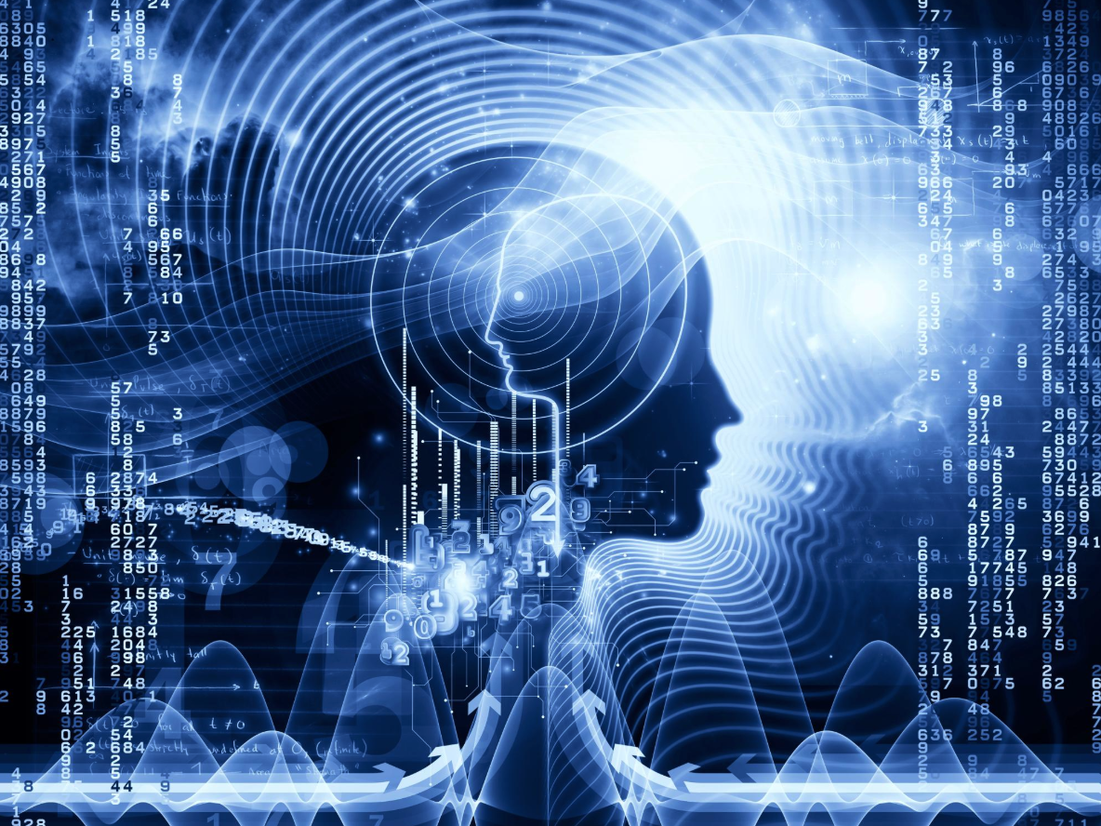
Chongqing University of Technology
ATAI
Advanced Technique of Artificial Intelligence
Chongqing University of Technology
1.Background
2.Method
3.Experiments
4.Conclusion

Slide 3
Background
Training GNNs usually requires abundant labeled data, which are often limited and expensive to obtain
Conventional GNN pre-training methods follow a two-step paradigm:
1)pre-training on abundant unlabeled data and
2) fine-tuning on downstream labeled data
there exists divergence of optimization objectives in the two steps.

Slide 4
Method
GNN
Node-level representation:
Graph-level representation:

Slide 5
Method
Conventional GNN Pre-training.
Learning to Pre-train GNNs.
To pre-train a GNN model over a graph ,we
sample some sub-structures from ,denoted 、
The objective of pre-training is to optimize the following:
The fine-tuning process aims to maximize the performance on the testing graph data:

Slide 6
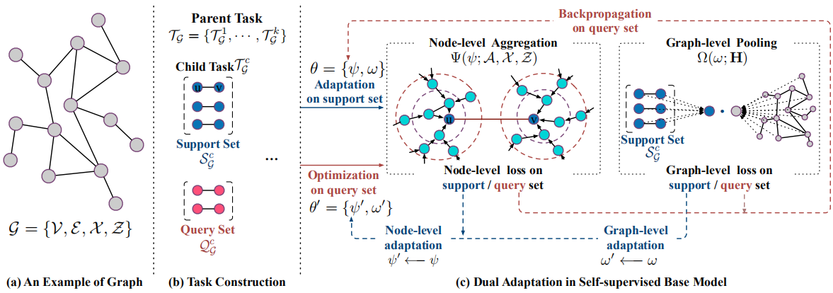
Method
L2P-GNN

Slide 7
Method
Task Construction.
To promote both global and local perspectives of a graph, its corresponding task is designed to contain k child tasks：
where the support and query contain edges randomly sampled from the edge distribution of the graph。

Slide 8
Method
Node-level loss
Graph-level loss
denotes the shifted graph representation by randomly shifting some dimensions of
Total loss

Slide 9
Method
Node-level Adaptation
To simulate the procedure of fine-tuning on training data:
To encode how to pool node information for representing a graph
Graph-level Adaptation

Slide 10
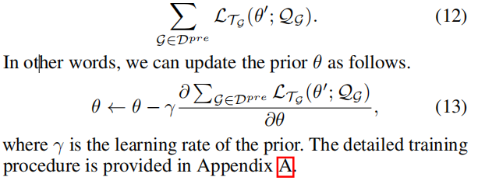
Method
Optimization of Transferable Prior
To mimic the testing process with the fine-tuned
model. That is, the transferable prior θ = {ψ, ω}
will be optimized through the backpropgation of
the query loss given by

Slide 11
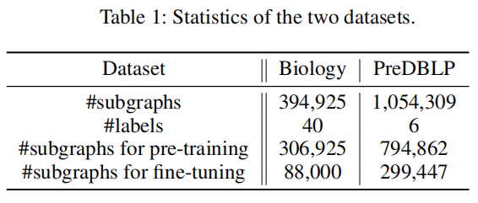
Experiment

Slide 12
Experiment

Slide 13
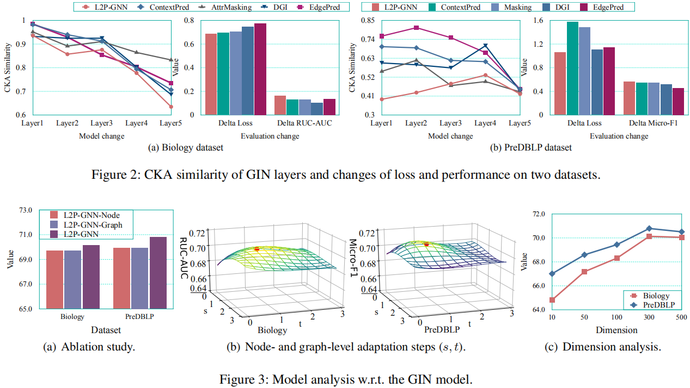
Experiment

Slide 14
Chongqing University of Technology
ATAI
Advanced Technique of Artificial Intelligence
Chongqing University of Technology
Thank you!

